Slide 1




The Meaning Behind the Jubilee Logo

Slide 2


What is the significance of the Logo?
Four figures, representing everyone on earth, all different kinds of people from all different places on earth.
They embrace each other to show solidarity, friendship and that we should be one united, global family.

Slide 3
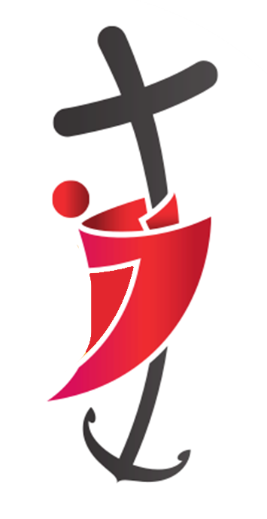
The cross is not only the sign of the faith, but also a sign of hope.
The lead figure at the front is holding onto the cross
We never let go of hope because we always need it, especially when we face difficulties!

Slide 4

There are the rough waves under the figures, symbolising the fact that life’s pilgrimage does not always go smoothly in calm waters.

Slide 5


The lower part of the cross has been stretched and turned into the shape of an anchor which is let down into the waves. The anchor is well known as a symbol of hope.
Sailors sometimes use the phrase the ‘anchor of hope’ which is an extra, reserve anchor that ships use to keep themselves steady during storms.

Slide 6
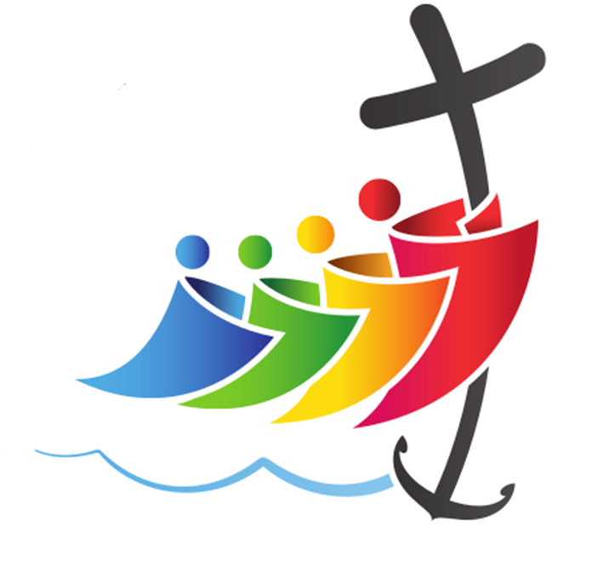
The cross also bends down towards the people, not leaving them alone, but stretching out to them as a reassuring presence, offering the safety of hope.
The pilgrim’s journey is something that everyone is doing together, not by themselves, and they are all leaning in closer to the cross.

